Slide 1
Predicting hotel reservation Cancellations
By: Abhishek U

Slide 2
Introduction
This report outlines the methodology, data preprocessing steps, model development, and evaluation processes employed in the hotel reservation cancellations prediction project. The goal is to predict potential cancellations.

Slide 3
Data Collection
Dataset Source: Spinnaker Analytics
Features:
'Booking_ID', 'no_of_adults', 'no_of_children', 'no_of_weekend_nights', 'no_of_week_nights', 'type_of_meal_plan', 'required_car_parking_space', 'room_type_reserved', 'lead_time', 'arrival_year', 'arrival_month', 'arrival_date', 'market_segment_type', 'repeated_guest', 'no_of_previous_cancellations', 'no_of_previous_bookings_not_canceled', 'avg_price_per_room', 'no_of_special_requests'
Target:
booking_status

Slide 4
Data Pre-processing
The dataset contains the following columns: 'Booking_ID', 'no_of_adults', 'no_of_children', 'no_of_weekend_nights', 'no_of_week_nights', 'type_of_meal_plan', 'required_car_parking_space', 'room_type_reserved', 'lead_time', 'arrival_year', 'arrival_month', 'arrival_date', 'market_segment_type', 'repeated_guest', 'no_of_previous_cancellations', 'no_of_previous_bookings_not_canceled', 'avg_price_per_room', 'no_of_special_requests‘,’booking_status’.
The dataset has 36275 rows and 19 columns
Dataset does not contain duplicates or missing values
14 columns are Numerical/ Continous data columns and 5 Categorical Columns, including Target Column.

Slide 5
Exploratory Data Analysis
Key Insights: Univariate Analysis Numerical Features
The majority of room bookings are made for 2 adults, followed by solo travelers and small groups. Most bookings are made without children.
Most bookings are for short weekend stays, and the majority include 2-3 weeknights, suggesting a mix of leisure and business travelers.
There is a significant increase in bookings from July to August, peaking in August, followed by a decline.
A majority of rooms are more affordable, with a smaller number of high-priced rooms.
The vast majority of bookings have no special requests, but a small segment includes multiple special requests.

Slide 6
Exploratory Data Analysis
Key Insights: Univariate Analysis Categorical Features
Meal Plan 1 is the most popular, while Meal Plan 3 is barely selected. Many guests did not opt for a meal plan.
Most guests do not require parking, with only a small fraction requesting it.
Room Type 1 dominates bookings, while other room types have minimal reservations.
Online bookings dominate, while corporate and complementary bookings are minimal.
Most guests are first-time visitors, with a low retention rate.
Clear imbalance in the dataset, visible in booking_status.

Slide 7
Exploratory Data Analysis
Key Insights: Bivariate Analysis Numerical Features
Canceled bookings tend to have longer lead times, implying that longer booking horizons may correlate with a higher risk of cancellation.
Customers with a history of cancellations are more likely to cancel again.
Customers with more non-canceled bookings are less likely to cancel.

Slide 8
Exploratory Data Analysis
Key Insights: Bivariate Analysis Categorical Features
Meal Plan 1 has the highest number of bookings and cancellations.
Guests who require car parking spaces tend to not cancel as frequently.
Room Type 1 has the highest booking and cancellation rate.
Complementary bookings have a very low cancellation rate, while Online bookings have a higher cancellation rate than Offline bookings.
Repeated guests have a higher cancellation rate compared to first-time guests.
More not-canceled bookings than canceled ones, which may affect the analysis of cancellation predictors.

Slide 9
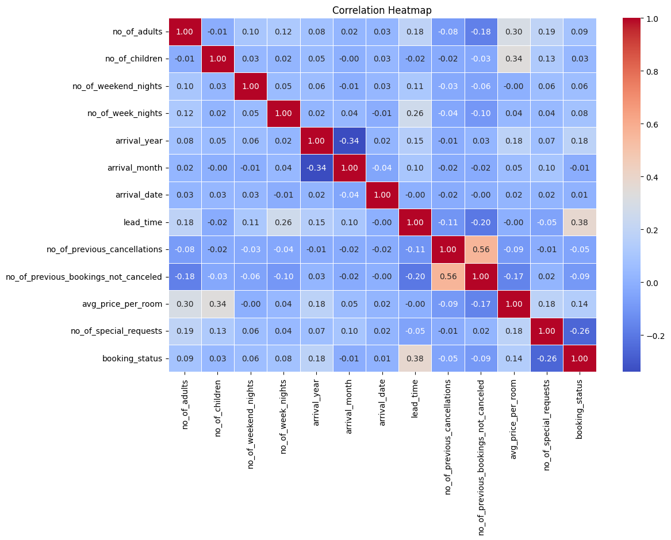
Checking correlation
Lead Time (0.38) has the highest positive correlation with booking status.
Negatively correlated (-0.26), meaning more special requests reduce the likelihood of booking.
Average Price per Room (0.14) shows a slight positive correlation.
Weak negative correlation (-0.05), suggesting past cancellations slightly reduce booking likelihood.

Slide 10
Feature selection
Feature Set 1:
['no_of_adults', 'no_of_children', 'no_of_weekend_nights', 'no_of_week_nights', 'arrival_month', 'arrival_date', 'lead_time', 'no_of_previous_cancellations', 'no_of_previous_bookings_not_canceled', 'avg_price_per_room', 'no_of_special_requests', 'meal_Meal Plan 1', 'meal_Meal Plan 2', 'meal_Meal Plan 3', 'meal_Not Selected', 'room_Room_Type 1', 'room_Room_Type 2', 'room_Room_Type 3', 'room_Room_Type 4', 'room_Room_Type 5', 'room_Room_Type 6', 'room_Room_Type 7', 'market_Aviation', 'market_Complementary', 'market_Corporate', 'market_Offline', 'market_Online', 'required_car_parking_space', 'repeated_guest', 'booking_status']
Feature Set 2:
['lead_time', 'no_of_special_requests', 'avg_price_per_room', 'no_of_previous_bookings_not_canceled', 'repeated_guest', 'market_Online', 'market_Aviation', 'no_of_week_nights', 'required_car_parking_space', 'arrival_month', 'no_of_adults', 'market_Complementary', 'market_Corporate', 'meal_Meal Plan 2', 'arrival_date', 'market_Offline', 'no_of_previous_cancellations', 'meal_Meal Plan 1', 'no_of_weekend_nights', 'no_of_children']
Feature Set 2 was Selected after Testing

Slide 11
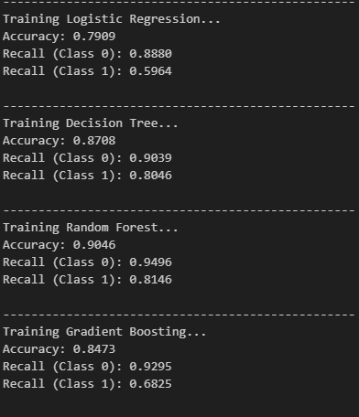
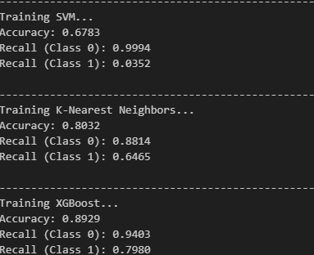
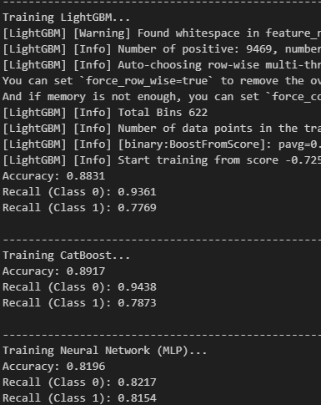
Model development & Evaluation
Multiple Models were Tested including:
Logistic Regression
Decision Tree
Random Forest
Gradient Boosting
SVM
K-Nearest Neighbors
XGBoost
LightGBM
CatBoost
Neural Network (MLP)
Random Forest showed the best performance.

Slide 12
Hyper parameter Tuning Using Grid Search for Random Forest
Feature Set 1:
Best parameters from random search: {'n_estimators': 100, 'min_samples_split': 10, 'min_samples_leaf': 2, 'max_features': 'sqrt', 'max_depth': 30, 'class_weight': 'balanced', 'bootstrap': False}
Best parameters from grid search: {'class_weight': 'balanced_subsample', 'max_depth': 35, 'max_features': 'sqrt', 'min_samples_leaf': 2, 'min_samples_split': 10, 'n_estimators': 150}
Feature Set 2:
Best parameters from random search: {'n_estimators': 400, 'min_samples_split': 5, 'min_samples_leaf': 4, 'max_features': 'sqrt', 'max_depth': None, 'class_weight': 'balanced', 'bootstrap': False}
Best parameters from grid search: {'class_weight': 'balanced_subsample', 'max_depth': None, 'max_features': 'sqrt', 'min_samples_leaf': 3, 'min_samples_split': 3, 'n_estimators': 350}

Slide 13
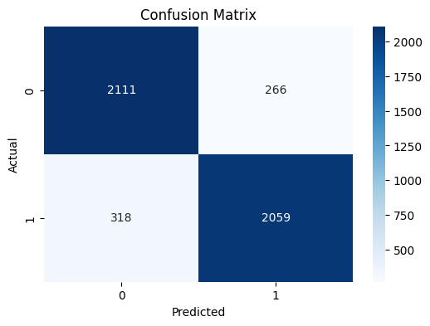
Conclusion
Random Forest is the Best Model
Feature Set 2 is the Best Feature Set
Best Parameter List for Random Forest is :{'class_weight': 'balanced_subsample', 'max_depth': None, 'max_features': 'sqrt', 'min_samples_leaf': 3, 'min_samples_split': 3, 'n_estimators': 350}
Recall is the Metric for Evaluation for this particular Problem: Hotel Reservation Cancelation Prediction
We achieved an average of 88 in Recall {Not-Canceled Class: 89 ,Canceled Class:87}
Final Accuracy of the Model is : 88

